Slide 1
Inventory Management System
Iteration 2
Team #10 Members:
Ibukunoluwa “Abby” Aboderin
Mason Beckham
Raghad Safauldeen
Siddharth Vadgama

Slide 2
Five Major Risks
Time management and communication
Risk Exposure: 85% * 8 Hours = 6.8 Hours
Lack of certain programming language knowledge and skills
Risk Exposure: 60% * 4 Hours = 2.4 Hours.
Our software is free, open source so all libraries used must be open source
Risk Exposure: 30% * 4 Hours = 1.2 Hours
Website might not work on certain browsers
Risk Exposure: 20% * 6 Hours = 1.2 Hours
Data limit on our server
Risk Exposure: 25% * 4 Hours = 1 Hour
Notes:
Raghad

Slide 3
Competitors: According to website 6 Best Inventory Management Software of 2019.
Company | Starting price per month
Ordoro | $25
Tradegecko | $79
Unleashed | $85
Veeqo | $200
Cin7 | $299
Fishbowl | $399
Notes:
raghad

Slide 4
Features
Primary:
Open source and free to use
Different style of scanning compared to competitors
User friendly and Simple
Admin Login System
Notes:
raghad

Slide 5
Assumptions
We will not pay for our host server
Our software is not customized for businesses like catering industry
Access to Local Area Network
Constraints
Since we are not paying for the server, only a limited amount of people can use our software
Notes:
raghad

Slide 6
Requirements
 | requirement | why? | how?
1a | Different style of scanning compared to competitors | To provide convenience and ease to the owner. They can pull out their phone anywhere to update inventory or add a new item | Business owners can use any phone with a camera to scan barcodes
1b | Different style of scanning compared to competitors | Small business owners do not need to spend additional funds on a designated hardware for scanning | No additional device is needed, just a mobile phone with access to website and log in
Notes:
Abby-discuss 1, maybe 2

Slide 7
Requirements Engineering(why? And how?)
2 | Admin Login System | To provide different levels of abstraction for different users | A password login based system for each user, and the business owner is solely able to give authorization to each person
3 | User friendly and Simple | To make inventory taking easy to understand and attractive to switch to from old excel spreadsheets | Creating a simple user interface in the website with navigation header, visual branding, and icons
4 | Open source | So we can provide a free service to small business owners and startup | Making sure everything used in programming phase is open source, to avoid support through an income stream
Notes:
Abby

Slide 8
Testing Requirements
Requirements | Testing for requirement
Different style of scanning compared to competitors | Barcode scanning will work on all modern mobile phone devices with a camera
Admin Login System | Password access needed to login to inventory, try common attack vectors for vulnerabilities
User friendly and Simple | Send a survey to a diverse group of individuals, ranging from age, socio-economic status and race and have them rate the website based on a list of questions.
Open source | Software documentation indicating its open source, users will be able to audit the software to detect bugs, and all packages used within the project will be verified as open source.
Notes:
Abby--discuss 2

Slide 9
Use case stories
Scan Barcode
Search Item
Deleting Item
Update Item Description
Sell Item

Slide 10
Use case story
Name:Scan Barcode
Primary actor: Business owner/employee
Stakeholders and interest: business owner or employee: wants to scan the barcode of an item quickly with minimum errors; wants to update the quantity in the inventory, each item has its own bin with a unique barcode and quantity.
Preconditions 1. The item is identified 2. The device used for scanning has to be turned on and working correctly
Postconditions: 1. The device scans the item 2. The inventory is updated
Notes:
Abby-quick overview

Slide 11
Use case story
Main success scenario: 1. The device scans the item successfully 2. The system records the new quantity in each bin, and displays a message indicating this current quantity 3. The system prompts the user to scan new item. If the user says yes, it continues, else, it goes to the first default page
Extension: a. If the scanner scanned the barcode of an item and it was not identified in the system: System prompts user to re-scan and check the the barcode for any defect After re-scanning, the system prompts the user to create a new bin that will include the new item The system updates the inventory *b. At any time, System fails: To support recovery and correct the inventory system, ensure all operations can be recoverable for any step of scenario.
Notes:
abby

Slide 12
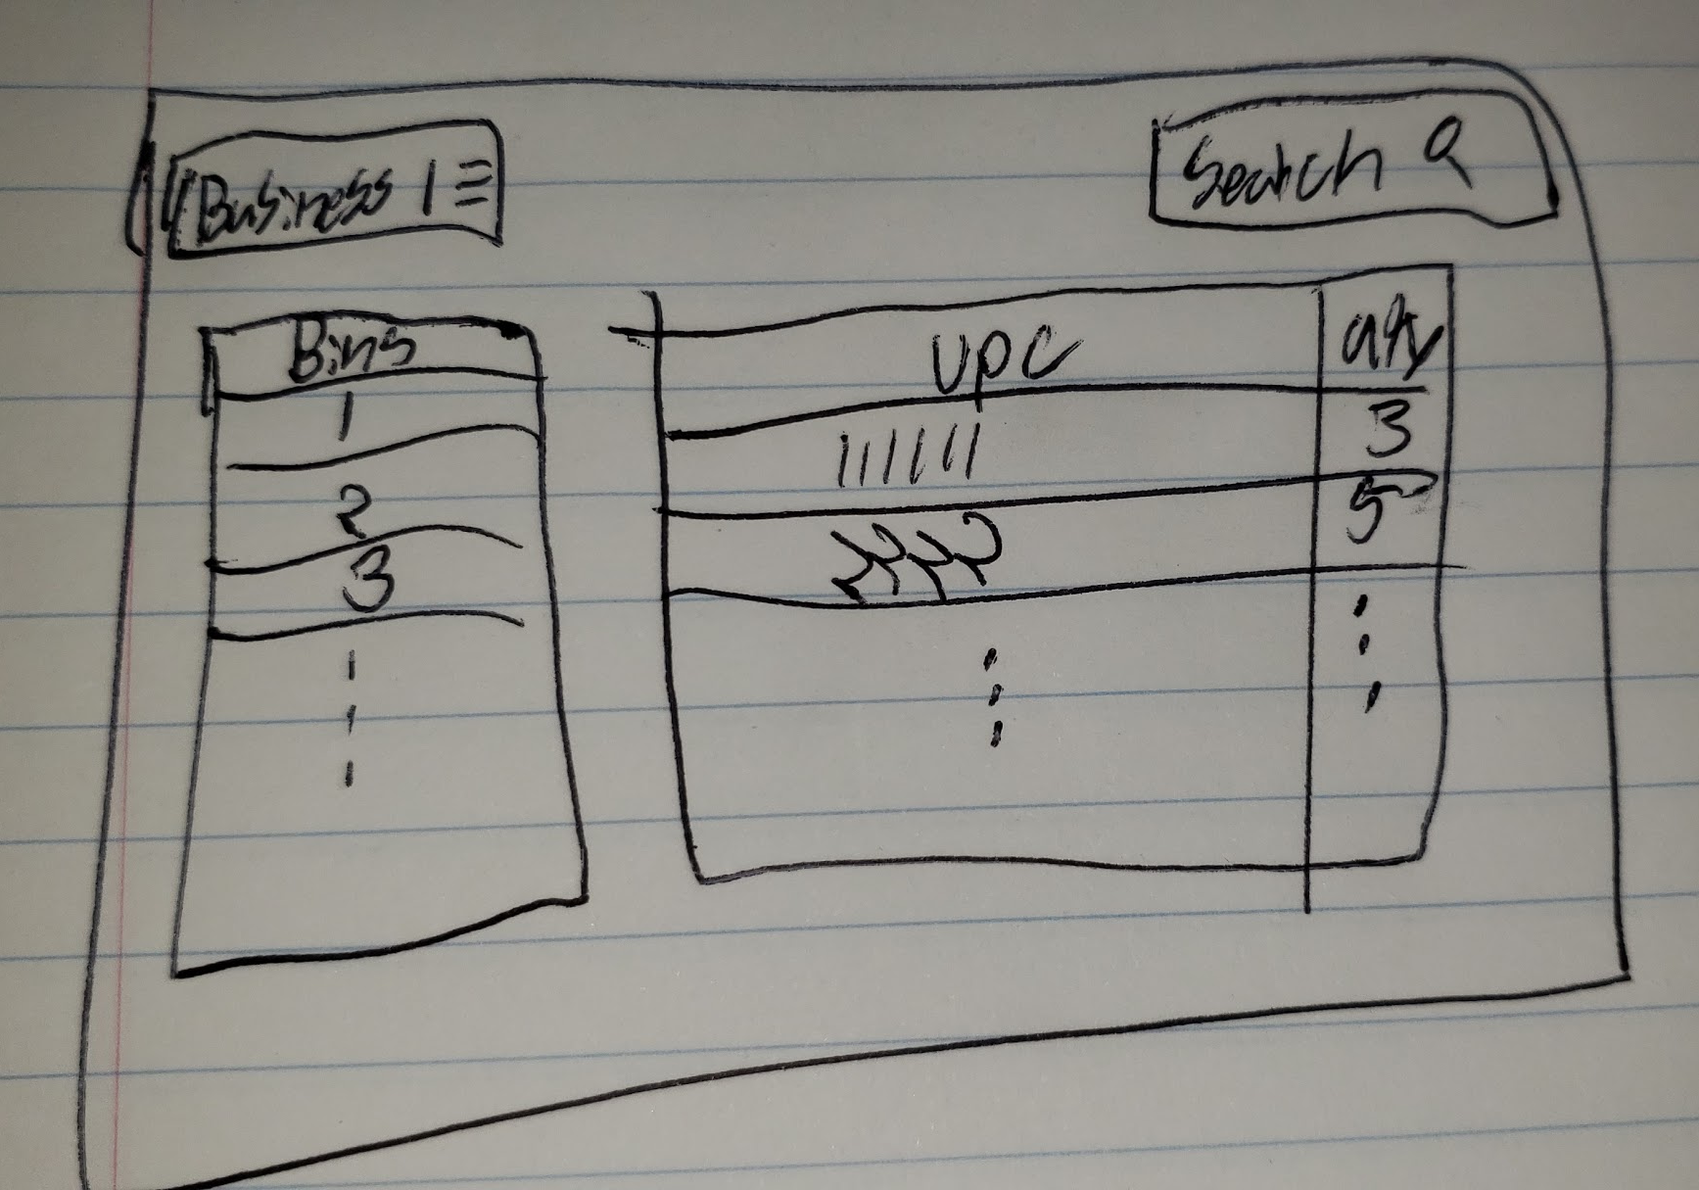
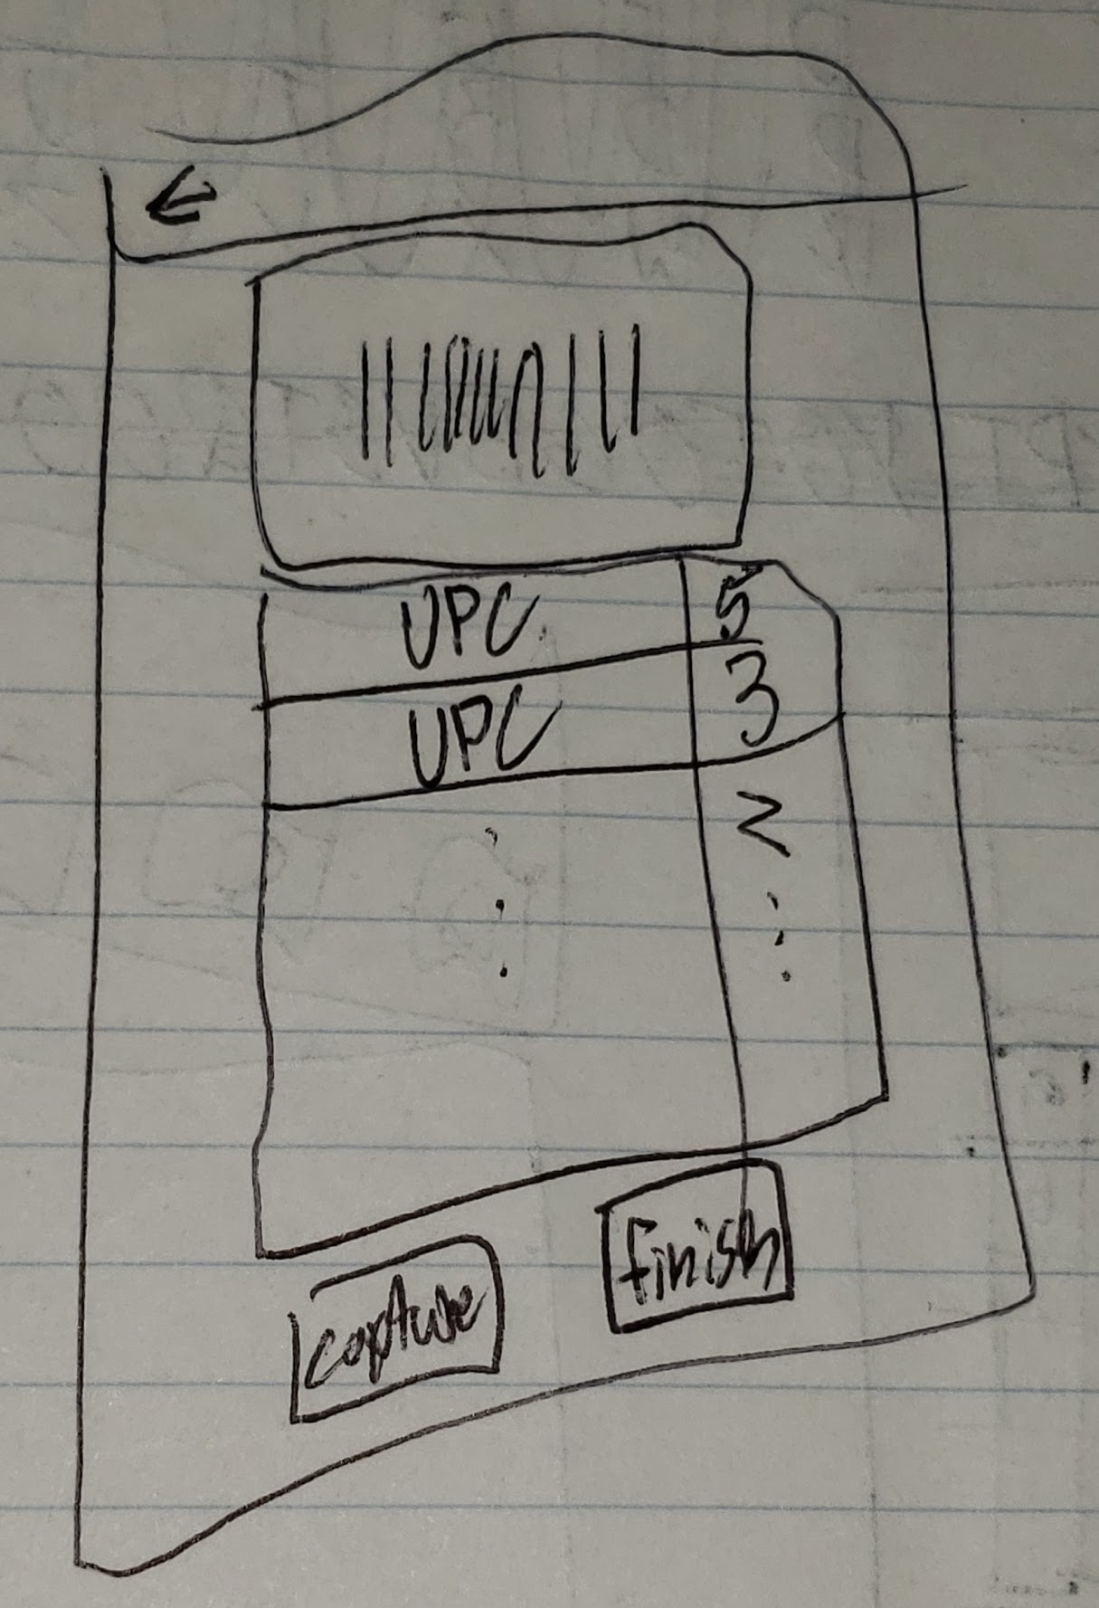
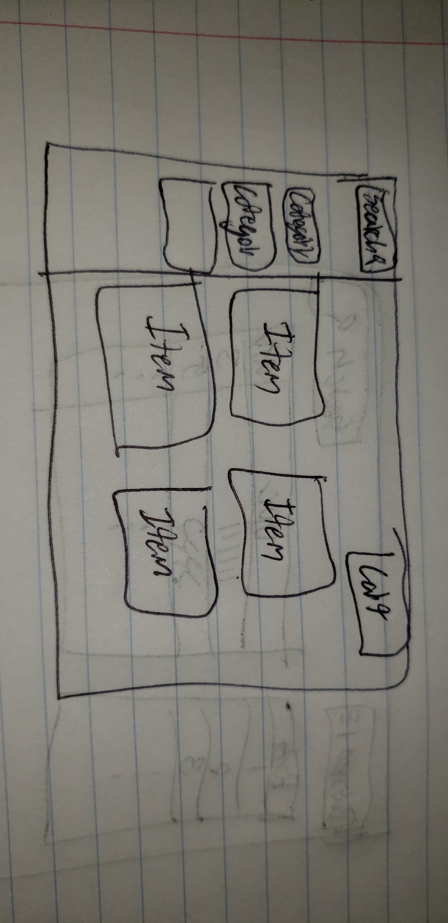
UI Prototype
Inventory Scanning Shopping Page Website Inventory Management
Notes:
Sid

Slide 13
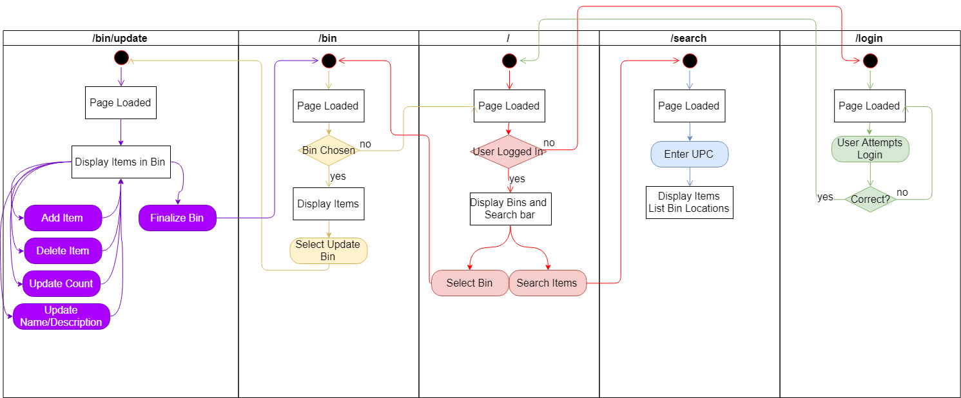
Website Use-Case diagram
Notes:
sid

Slide 14
Testing
Multiple Node JS packages which provide great code coverage and simple implementations will be used for testing.
Mocha, Supertest provide functionality for running tests as well as testing HTTP requests.
Chai provides an assertion library that makes tests simpler to understand and are less error prone.
Husky and Lint-Staged allow tests to be run every time a commit is made, this ensures that if something fails to work it will not be added to the code base.
Manual Tests can be done by running ‘npm run test’
Notes:
sid

Slide 15
Software Development Plan
Iteration PlanFuture
Iteration 1: the first iteration will be getting the underlying technology stack in
place to allow for integration of the UI and backend services.
Iteration 2: login and registration, API (complete backend), basic UI for frontend,
Iteration 3: complete UI, barcode scanning, system primary requirements
(everything that needs to be done is done), and hallway testing(create a survey and rating system to get feedback from people)
Final Deliverable: testing, additional requirements are added based on priority.
Notes:
sid

Slide 16
Software Development Plan
Tools
Programming application: JavaScript, MySQL, HTML, CSS, bootstrap, NodeJS
GitHub for collaboration: https://github.com/uta-cse-3311/inventory_management
Cloud: amazon web service
Agile Scrum software development: implementation and unit testing
People
Members of CSE 3311 Team 10
Review Team 11
Professor Christoph Csallner and TA Soumik Mohian
Notes:
sid

Slide 17
Software Development Plan
Education
Members have a foundational knowledge of programming and computer science, but education is needed on the some of the languages being used.
Licensing
The MIT license will be used for the project as it allows for free use to anyone, but bars any liability and warranty requirements from the project group.
Notes:
sid

Slide 18
References
“6 Best Inventory Management Software of 2019.” Business.org, Business.org, 16 Jan. 2019, www.business.org/finance/cost-management/best-inventory-management-software/.

Slide 19
Demo & Code
Notes:
Mason

Slide 20
Questions & Answers

